Slide 1
MiDas Models for Point Clouds
2022 Data Science Capstone
Dr. Osama Abuomar
Seth Howells - DATA-59000

Slide 2
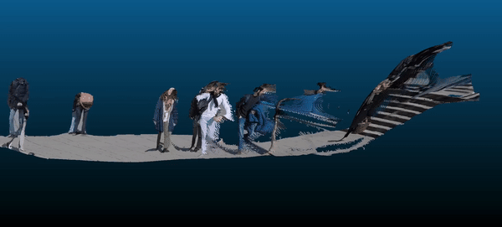

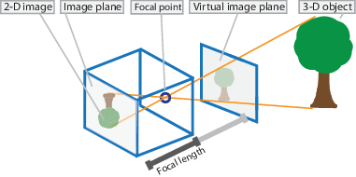
Terminology
Point Cloud: set of points representing a 3D shape or object
Depth Maps: image representation containing information describing the relationship of object surfaces to viewpoint
Projection Matrix: matrix which describes the mapping of 2D points to 3D points

Slide 3
Methodology: Overview
Intrinsic Camera Parameters
Input Image
X, Y
MiDas Small-CNN
MiDas Hybrid-DPT
MiDas Large-DPT
Z-depth
X, Y, Z
Q-Matrix
Polygon File
RGB-mask
X, Y, Z, RGB
PointCloud_{S,H,L}
Production-Rate Analysis
Outlier Analysis
Point-Based Analysis
Point Cloud Comparison
Notes:
Input images from dataset containing intrinsic camera matrix.
Fed through depth estimation models to obtain Z-depth.
Form reprojection matrix with Q. Pixel to Voxel.
Apply RGB-mask to voxels.
Polygon (PLY) file created.
Analysis.

Slide 4
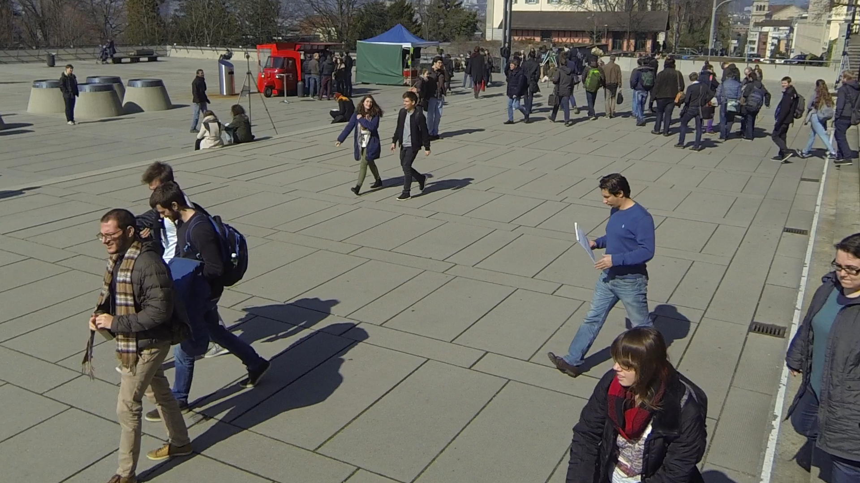


Part 1: MiDas Monocular Depth Estimation
Input Image
X, Y
MiDas Small-CNN
MiDas Hybrid-DPT
MiDas Large-DPT
Z-depth
MiDas models:
MiDaS v2.1 - Small (lowest accuracy, highest inference speed)
MiDaS v3 - Hybrid (medium accuracy, medium inference speed)
MiDaS v3 - Large (highest accuracy, lowest inference speed)
Small
Hybrid
Large

Slide 5
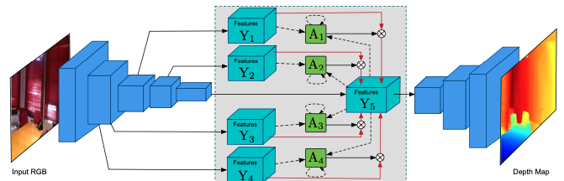
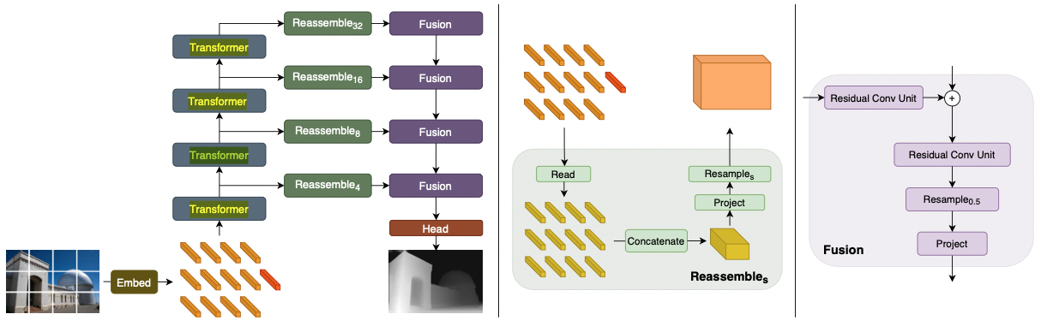
Convolutional Neural Networks (CNN) vs Dense Prediction Transformers (DPT)
CNN:
Loss of information during decoding phase
Struggles with Pose orientation
Performs poorly with different lighting in environment
DPT:
Architecture originally in NLP
Bag-of-words operation:
Image Patch = Words
Image = Sentence
Transform, Reassemble, Fuse batch

Slide 6
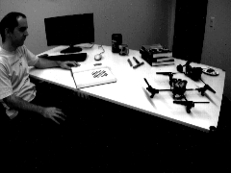
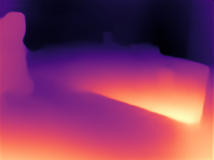

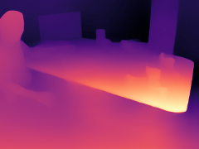
Spot the differences?
Input Image
MiDas Small-CNN
MiDas Hybrid-DPT
MiDas Large-DPT

Slide 7
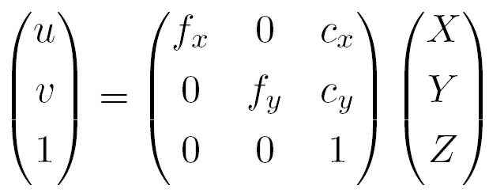
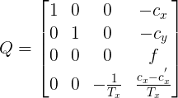
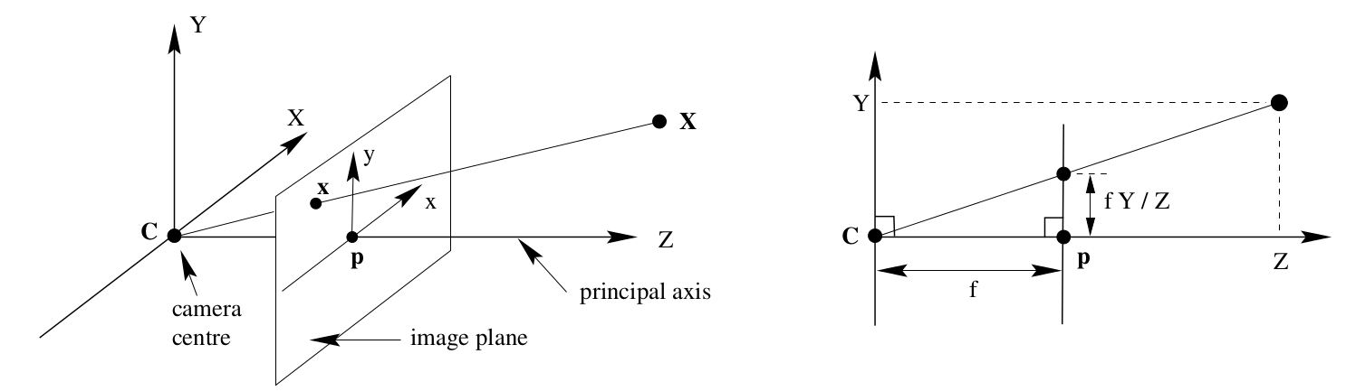
Part 2: Projection Matrix
Intrinsic Camera Parameters
Input Image
X, Y
MiDas Small-CNN
MiDas Hybrid-DPT
MiDas Large-DPT
Z-depth
X, Y, Z
Q-Matrix

Slide 8
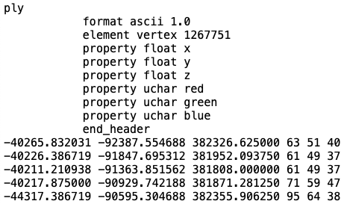
Part 3: Polygon File
Intrinsic Camera Parameters
Input Image
X, Y
MiDas Small-CNN
MiDas Hybrid-DPT
MiDas Large-DPT
Z-depth
X, Y, Z
Q-Matrix
Polygon File
RGB-mask
X, Y, Z, RGB
PointCloud_{S,H,L}

Slide 9
Part 4: Analysis and Results
Intrinsic Camera Parameters
Input Image
X, Y
MiDas Small-CNN
MiDas Hybrid-DPT
MiDas Large-DPT
Z-depth
X, Y, Z
Q-Matrix
Polygon File
RGB-mask
X, Y, Z, RGB
PointCloud_{S,H,L}
Point-Cloud Comparison
Outlier Analysis
Point-Based Analysis
Production-Rate Analysis

Slide 10
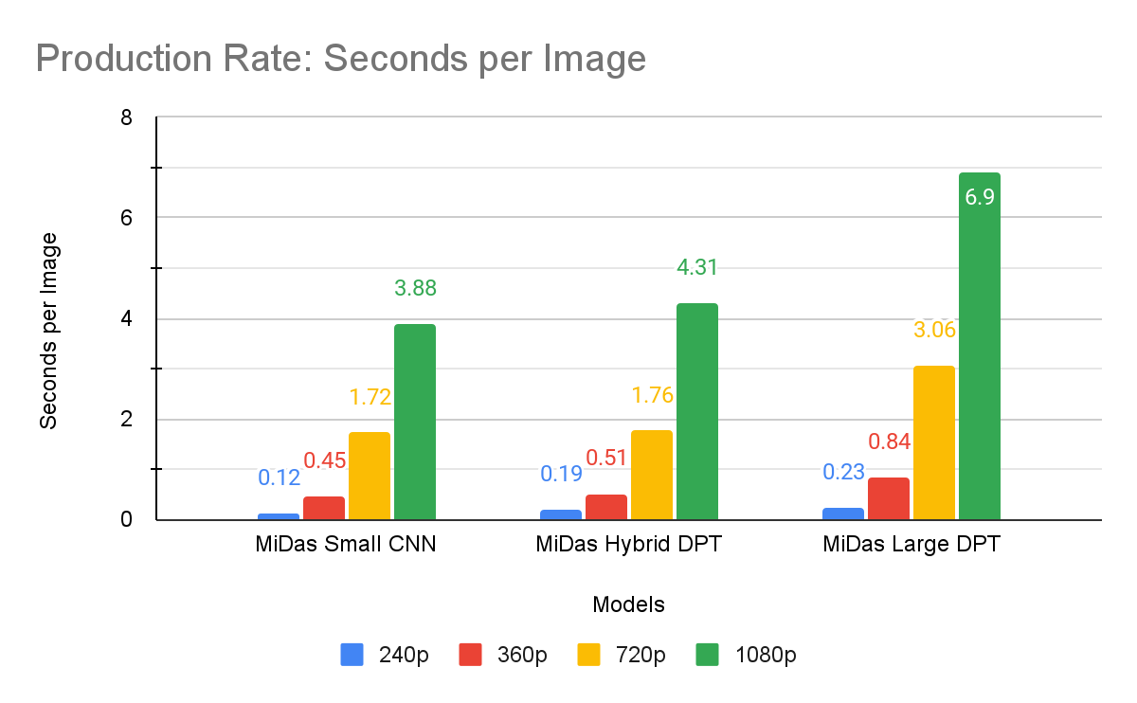
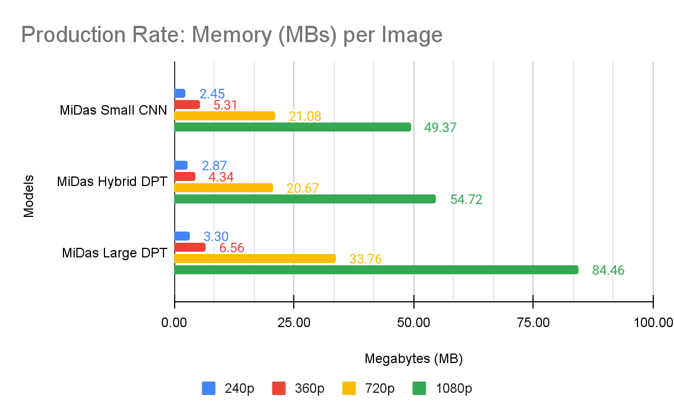
Results: Production-Rate Analysis
Progressively longer and larger files at each resolution
CNN known from computational efficiency
Hybrid-DPT fairs well against CNN
Large-DPT least computationally efficient

Slide 11

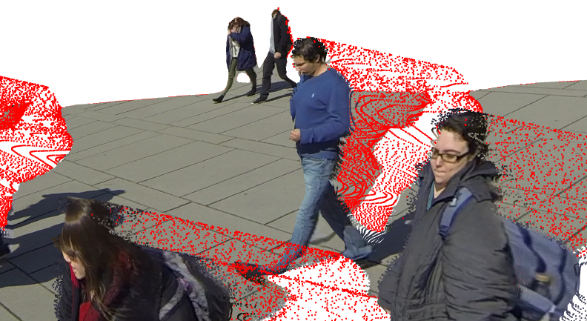
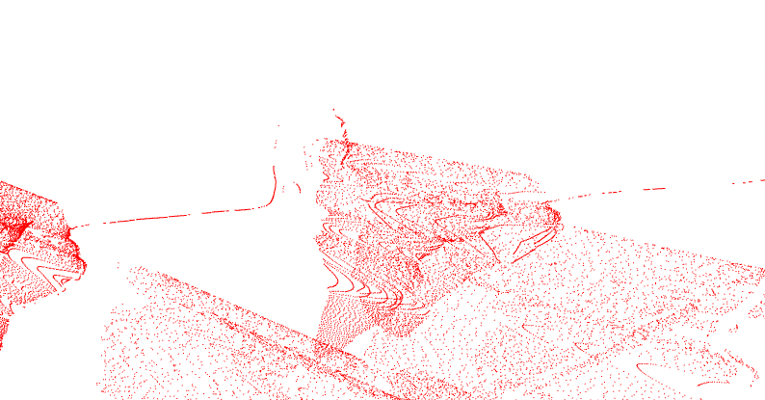
Results: Outlier-Detection Analysis
Outliers defined by:
Nearby Neighbors: avg distance from 30 neighbors
Threshold: 2.0 * standard deviation
Max Distance = Nearby Neighbors * Threshold
Outlier > Max Distance
CNN = highest percentage of outliers
DPT-Large = least percent outliers
% Outliers | Camera 1 | Camera 2 | Camera 5 | Camera 6
MiDas Small CNN | 0.03486 | 0.03114 | 0.04243 | 0.05645
MiDas Hybrid DPT | 0.01806 | 0.02478 | 0.01384 | 0.02859
MiDas Large DPT | 0.01744 | 0.02542 | 0.01560 | 0.02810
% Outliers | urban_1 | urban_2 | office_1 | office_2
MiDas Small CNN | 0.03428 | 0.04340 | 0.05182 | 0.03085
MiDas Hybrid DPT | 0.04642 | 0.04672 | 0.04953 | 0.02469
MiDas Large DPT | 0.01047 | 0.03371 | 0.03517 | 0.01796
Input Image
Inliers with Outliers
Outliers only

Slide 12
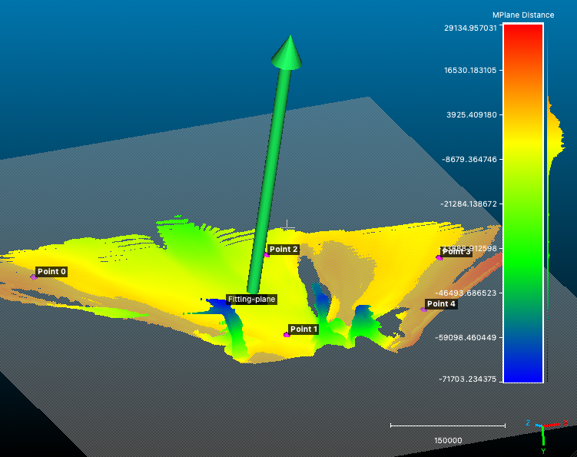
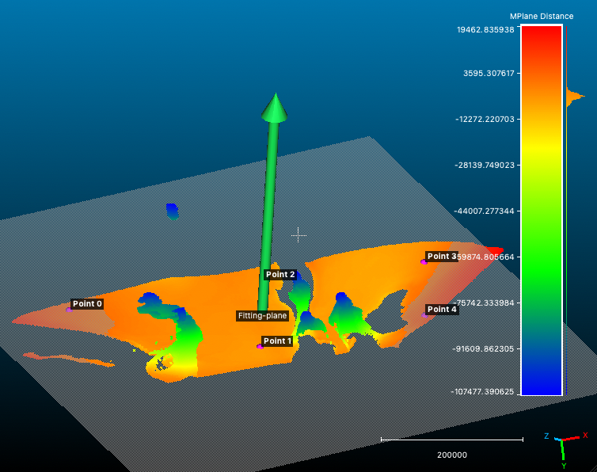
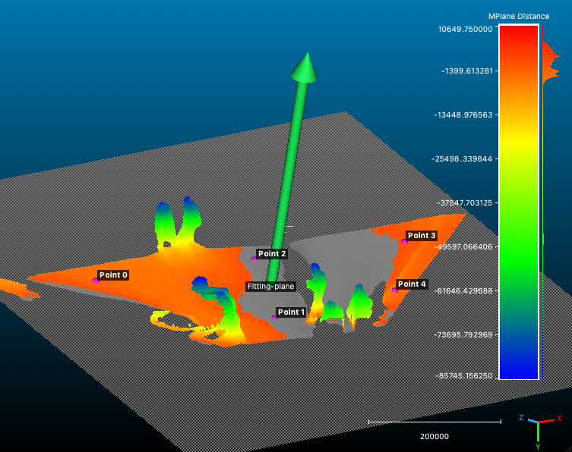
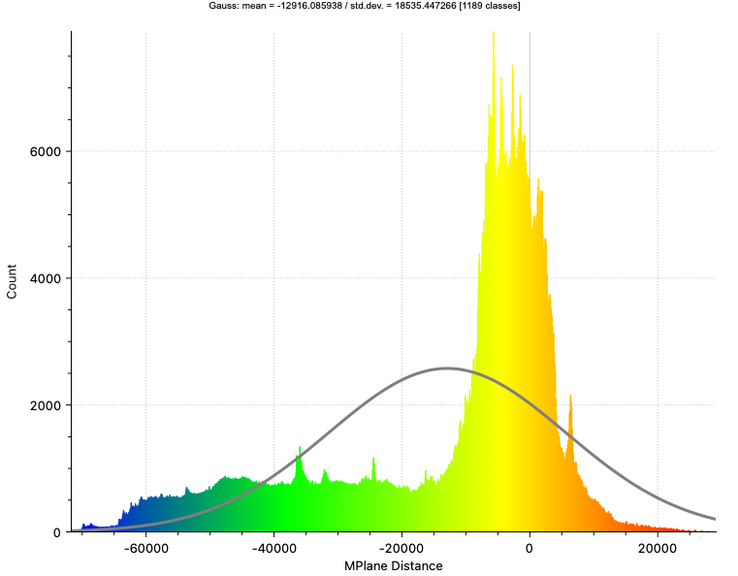
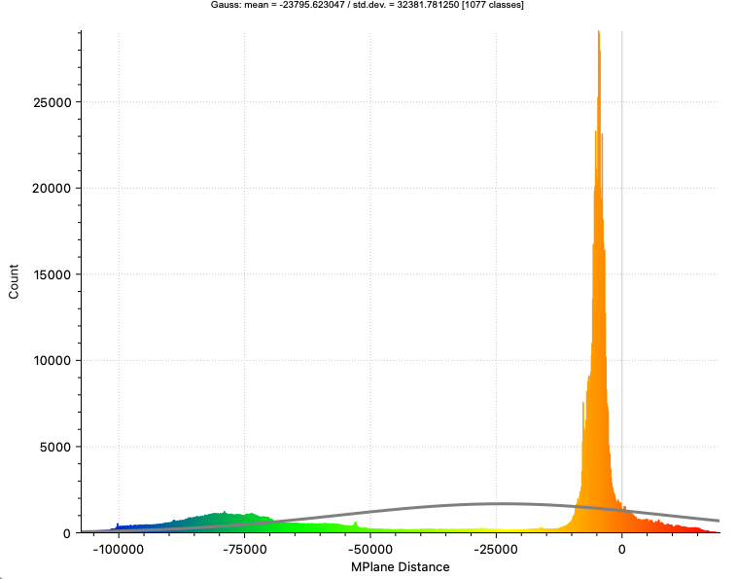
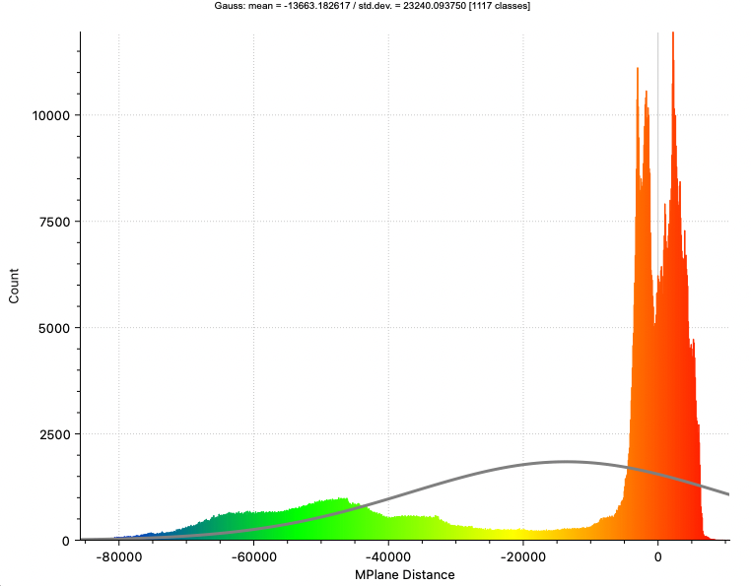
Results: Point-Based Analysis (Y-axis measure with MPlane)
MiDas Small-CNN
MiDas Hybrid-DPT
MiDas Large-DPT

Slide 13
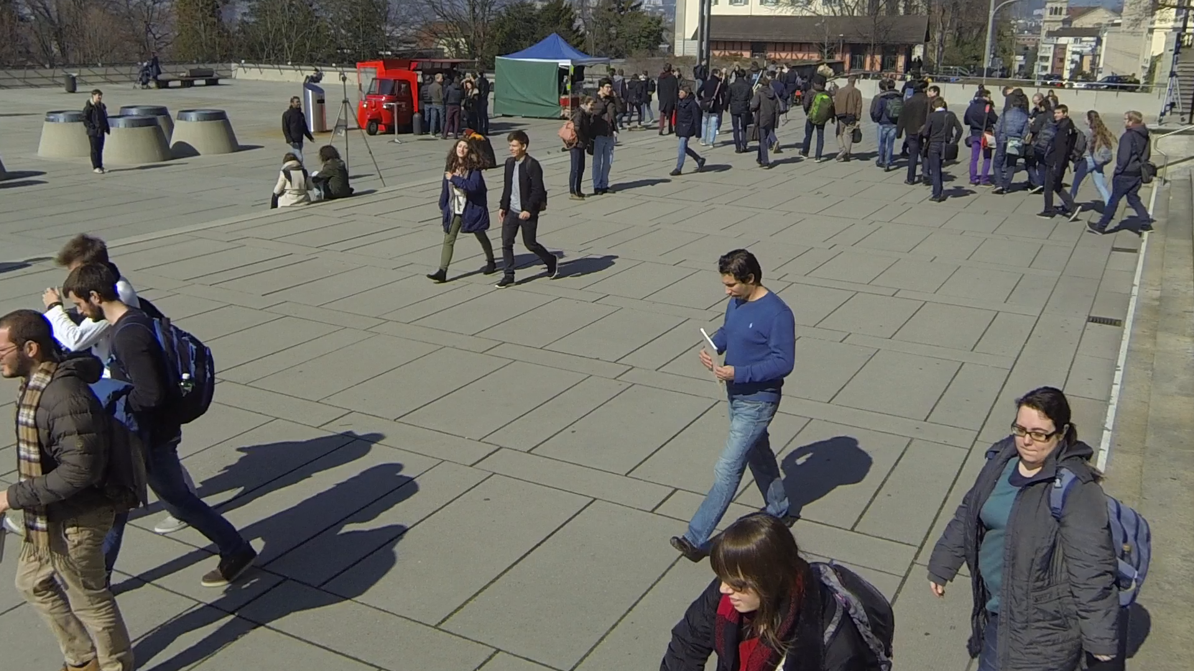
Results: Point Cloud Comparisons

Slide 14
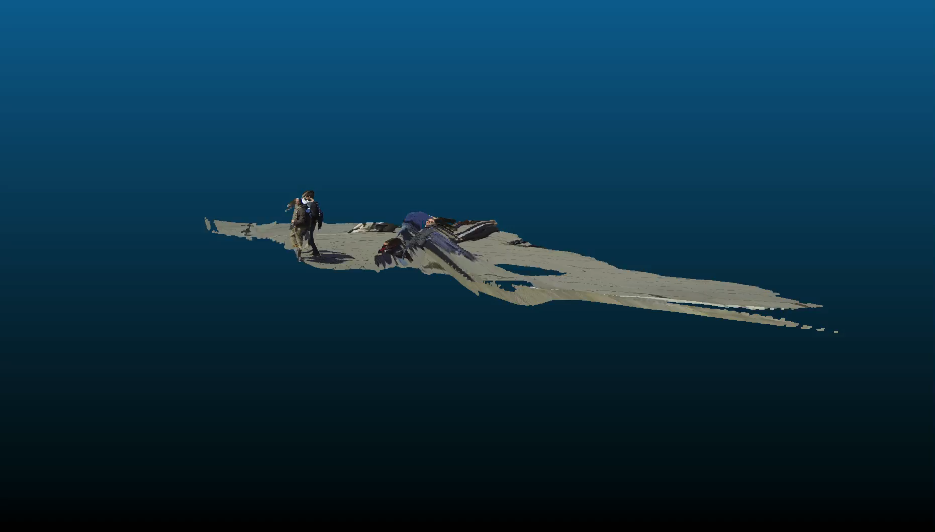
Point Clouds: Small-CNN

Slide 15
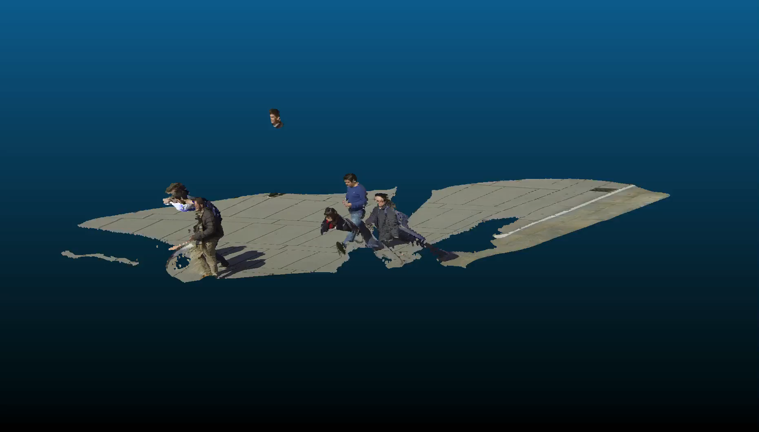
Point Clouds: Hybrid-DPT

Slide 16
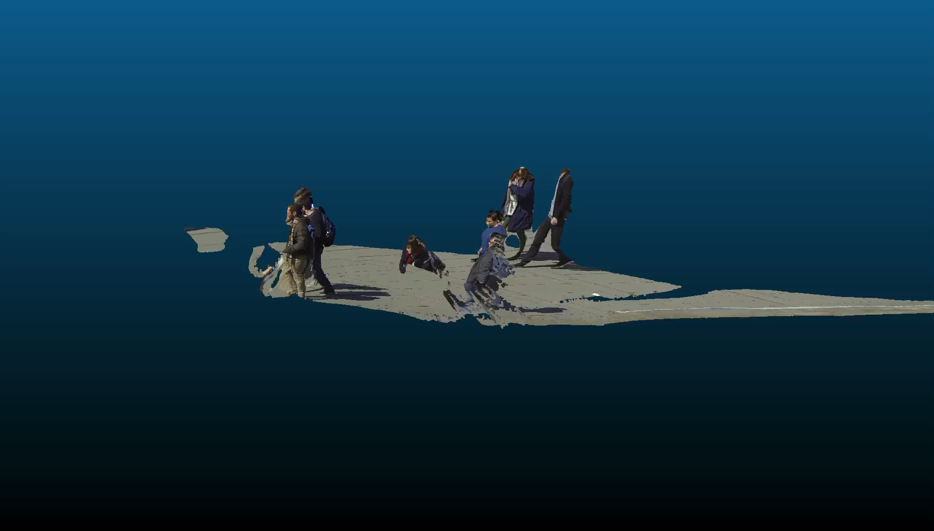
Point Clouds: Large-DPT

